Slide 1
Real Time Face Detection and Recognition in OpenCV with Python
Presented by
Mohammed Golam Sarwer Rakib

Slide 2
Content
Introduction
Literature Review
Objectives
Methodology
Result
Application
Future work
Conclusion
Reference

Slide 3
Introduction
A face recognition used for verifying a person and identifying him or her with a video or picture from a source.
One way from a face and an image database are the preferred facial features.
It is generally compared to biometrics like fingerprints and eye reconnaissance systems, and is used in security systems, thumb recognition systems.
Face detection and picture or video recognition is a popular subject of research on biometrics. Face recognition in a real-time setting has an exciting area and a rapidly growing challenge.

Slide 4

Literature Review
Face recognition involves three basic steps which include face detection, face recognition, and face extraction. Any system needs to encapsulate the image and then manage as well as record the vital features to determine the location of the face[2].
Face recognition takes an image from a video or a camera as input and outputs the identified image topic. Facial features may include regions in the face, variations in the face structure, face cuts and angles that have been formatted and styled.
Face extraction includes grabbing of the features from camera.
Fig : A Face Recognition System

Slide 5
Objectives
To detect face’s
To get accurate face recognition
To recognize face’s in real time

Slide 6
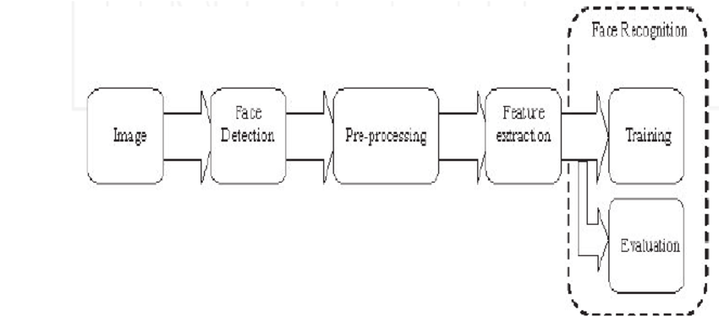
Methodology
The process is divided into the following steps
Face detection
Feature extraction
Classification

Slide 7
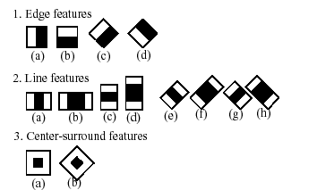
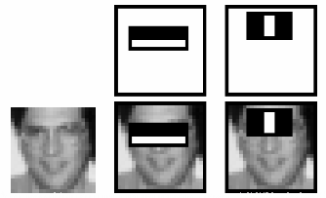
Methodology Cont.
Haar cascade classifier
A haar cascade is defined as: a sequence of "square shaped" functions which together form a family of wavelets or a base.
This is then used to detect objects Using "integral image“ principles in order to compute "features" identified by the haar cascades.
The cascade is measured by 1.25 and different sized faces are re-iterated in order to find it.
Large amount of computing power and time consumed by Running an image on cascade
Fig 1-Extraction features
Fig2-Haar cascade classifier view

Slide 8
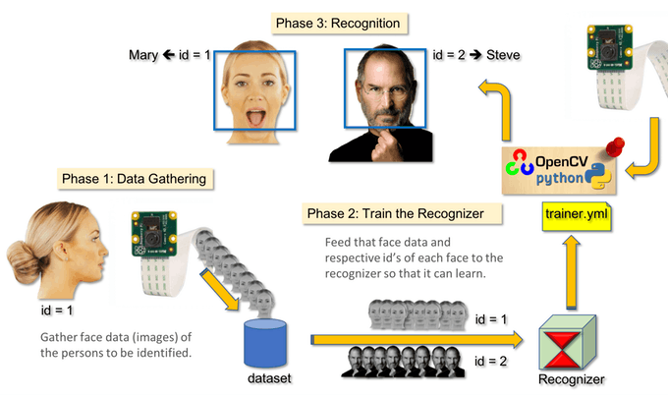
Methodology Cont.

Slide 9
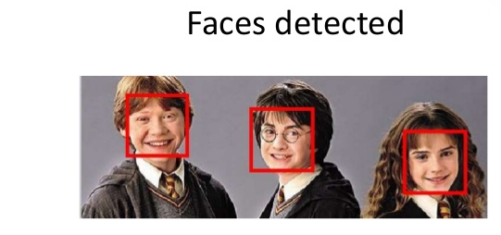
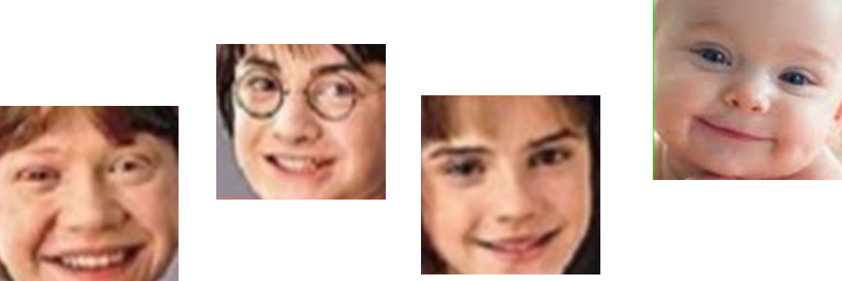
Result
Face Detection
Haar Cascade
Frontalface.xml
Generating dataset
Dataset in specific directory
Dataset with label
Dataset

Slide 10
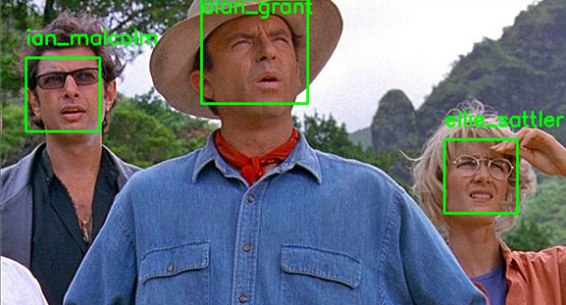
Result Cont.
Face Recognition
Training dataset
Using haar cascade classifier
LBPH Recognizer
Face’s are recognized

Slide 11
APPLICATIONS
video surveillances
security features. mobile phones and laptops for user recognition, face passwords.
smart attendance integrated with the payroll
it is used in the ATM.
Software’s like Picasa, Snapchat.
Companies like Facebook, Instagram.
Gaming field. Example - Xbox games.

Slide 12
Conclusion
In the last 20 years, facial recognition technology has come a long way.
Today can check identity information automatically with regard to safe transactions, tracking, security purposes and buildings access control.
Such systems normally work in controlled environments and algorithms of recognition may manipulate environmental constraints to achieve high accuracy of recognition.
Yet face-recognition technologies of next generation will be commonly used in smart settings where computers and machines are more like supportive helpers

Slide 13
Future work
It could be introduced in cabs to detect sleepiness of drives to reduce accident
In finding the lost kids, adults can come back to home.
It can be used at various metro station or an airport station to reduce the crime rate.

Slide 14
Reference
[1] Learning OpenCV –Computer Vision with the OpenCV Library O’Reilly Publication.
[2] Learning OpenCV: Computer Vision with OpenCV Library, Kindle Edition.Gary Bradsk1 and AndrianKehlar
[3] M.A. Turk and A.P. Pentland, “Face Recognition Using Eigenfaces”, IEEE Conf. on Computer Vision and Pattern Recognition, pp. 586-591, 1991.
[4] “KyungnamKim” Face Recognition using Principle Component Analysis”
[5] Codacus: https://youtu.be/1Jz24sVsLE4
[6] G B Huang, H Lee, E L. Miller, “Learning hierarchical representation for Face verification with convolution deep belief networks[C]”,Proceedings of International Conference on Computer Vision and Pattern Recognition,pp.223-226,2012.
[7] Computer Vision Papers, http://www.cvpapers.com
[8] Learning OpenCV: Computer Vision with the OpenCV Library 1st Edition, Kindle Edition
[9] OpenCV Homepage http://opencv.willowgarage.com
[10] Recognition Homepage http://www.face-rec.org/algorithms.

Slide 15


